Slide 1
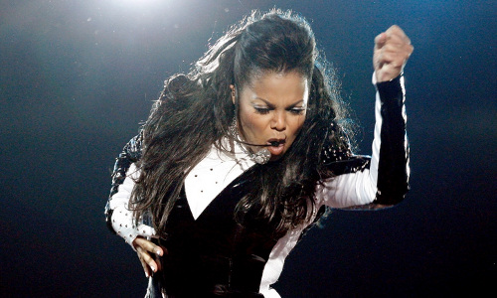
Welcome, everyone!! Course Introduction
A Janet Jackson Song Could Crash Windows XP Laptops!
…a sound frequency in Janet Jackson's song "Rhythm Nation" could crash a model 5400rpm laptop hard drive used in certain Windows XP notebooks… "Playing the music video on one laptop caused a laptop sitting nearby to crash, even though that other laptop wasn't playing the video!" Microsoft determined the song had a frequency that matched the laptop hard drive's natural resonant frequency, which caused its moving disks to over-vibrate and induce a crash..
www.pcmag.com/news/a-janet-jackson-song-could-crash-windows-xp-laptops

Slide 2
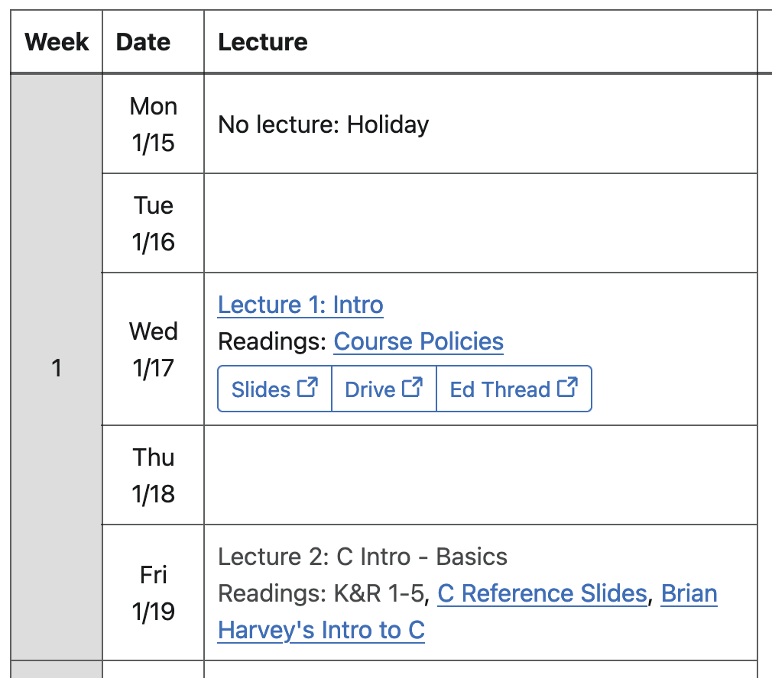

How to ask questions in CS61C Lecture
Option 1 (in-person):
Raise your hand
Option 2 (in-person, Zoom, or recording):
Post on Ed forum Lecture megathread
CS61C Course website:
https://cs61c.org/

Slide 3
Agenda
Thinking about Machine Structures
Thinking about Machine Structures
Great Ideas in Computer Architecture
What you need to know about this class

Slide 4
CS61C is NOT about C Programming…!!
It is about the hardware-software interface
What does the programmer need to know to achieve the highest possible performance
Languages like C are closer to the underlying hardware, unlike languages like Snap!, Python, Java
We can talk about hardware features in higher-level terms
Allows programmer to explicitly harness underlying hardware parallelism for high performance

Slide 5
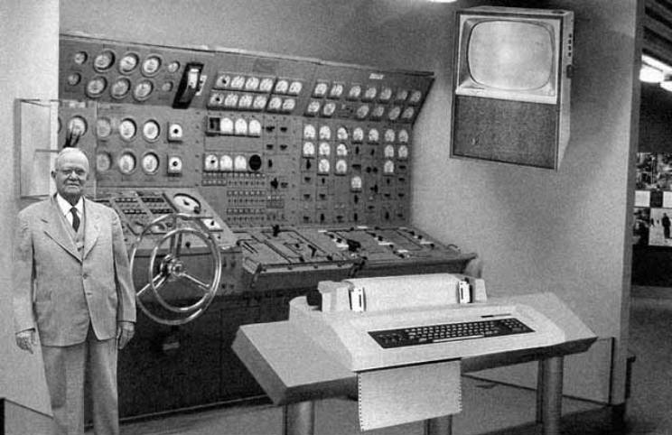
Old School CS61C

Slide 6
Old School CS61C
Note: This photo is fake

Slide 7
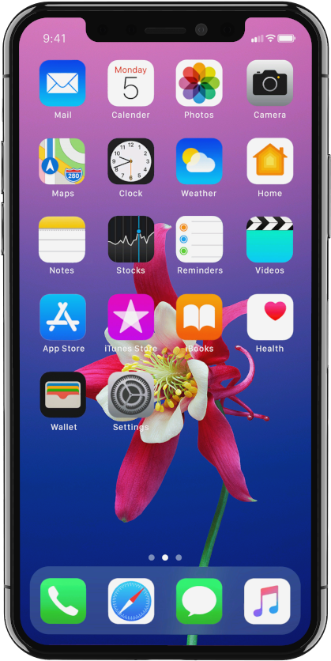
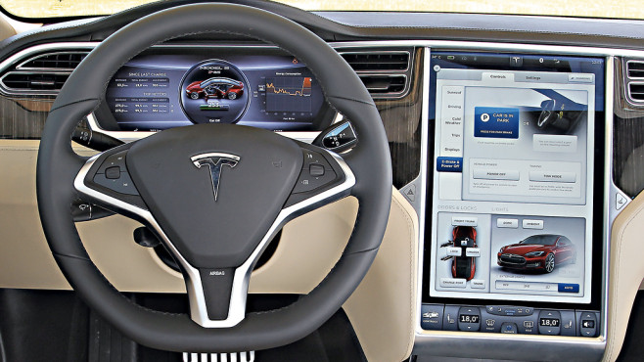
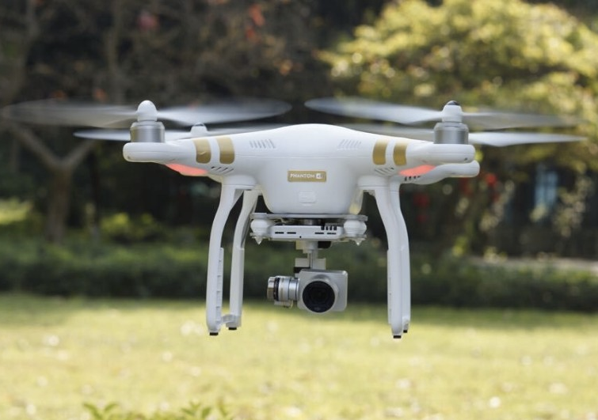
New School CS61C (1/3)
Personal Mobile Devices
Network Edge Devices

Slide 8
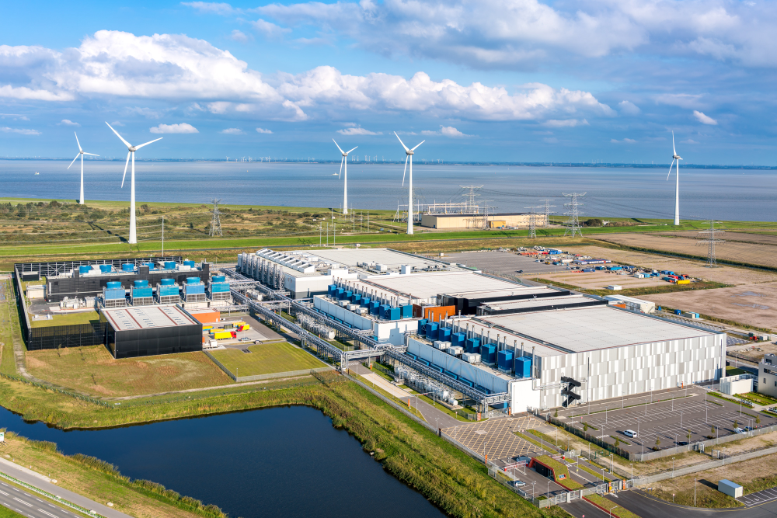
New School CS61C (2/3)

Slide 9


New School CS61C (3/3)
A popular laptop sticker

Slide 10
Old-school Machine Structures
Application (ex: browser)
Operating
System
(Mac OSX)
Compiler
Software
Assembler
Instruction Set
Architecture
Hardware
Processor
Memory
I/O system
Datapath & Control
CS61C
Digital Design
Circuit Design
Transistors
Fabrication

Slide 11




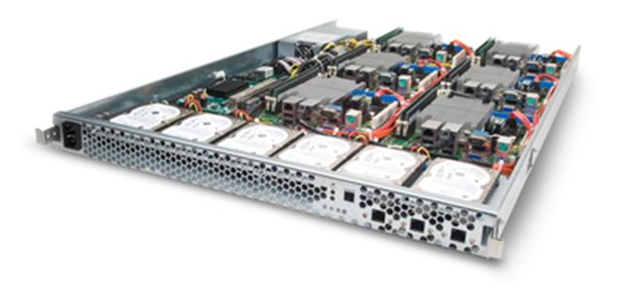
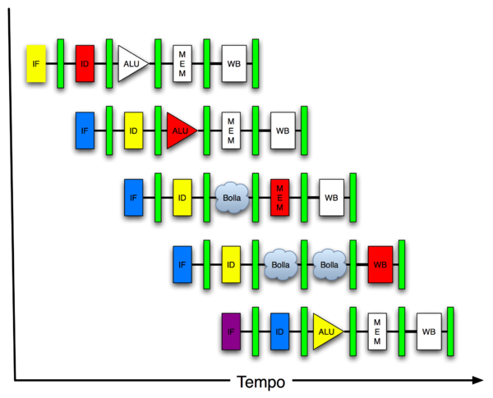
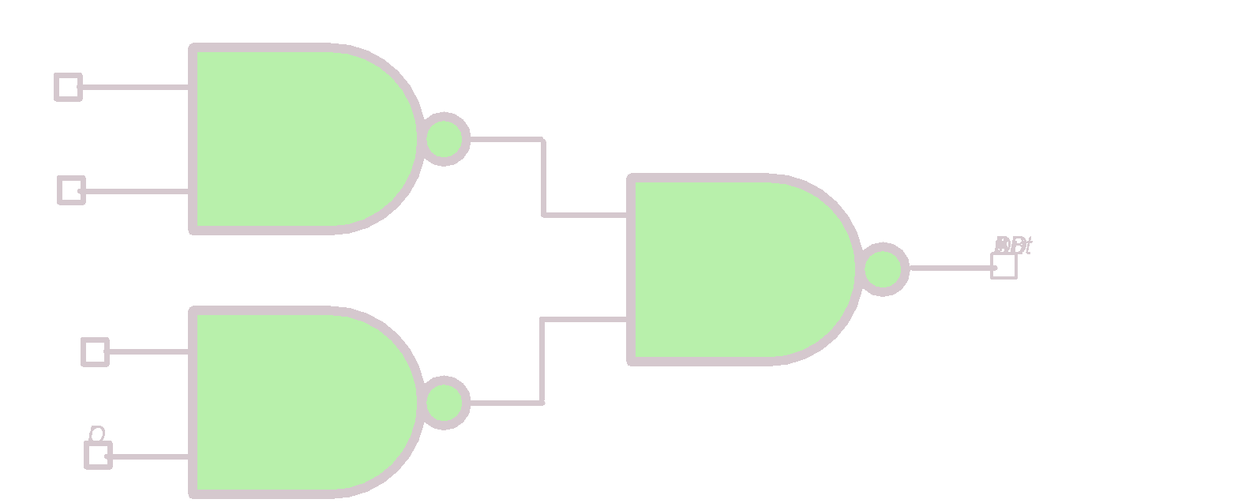
New-school Machine Structures
Software
Hardware
Parallel Requests
Assigned to computer
e.g., Search “Cats”
Parallel Threads
Assigned to core e.g., Lookup, Ads
Parallel Instructions
>1 instruction @ one time
e.g., 5 pipelined instructions
Parallel Data >1 data item @ one time
e.g., Add of 4 pairs of words
Hardware descriptions All gates work in parallel at same time
Warehouse Scale Computer
PC
Smart Phone
Computer
Core
Core
Harness Parallelism &
Achieve High Performance!!
Memory (Cache)
…
Input/Output
Exec. Unit(s)
Functional
Block(s)
A₀+B₀
A₁+B₁
Main Memory
Logic Gates

Slide 12
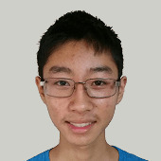
Agenda
Great Ideas in Computer Architecture
Thinking about Machine Structures
Great Ideas in Computer Architecture
What you need to know about this class

Slide 13
6 Great Ideas in Computer Architecture
Abstraction (Layers of Representation/Interpretation)
Moore’s Law
Principle of Locality/Memory Hierarchy
Parallelism
Performance Measurement & Improvement
(Extra) Dependability via Redundancy

Slide 14
Great Idea #1: Abstraction (Levels of Representation/Interpretation)
Structure and Interpretation of Computing Programs, my good friend…
import numpy
x = 3
x = "hello, world"
x = [3, "cs61a", True]
x = len
x = numpy
x = lambda x: x + 2
# anything can be a Python name!

Slide 15


Great Idea #1: Abstraction (Levels of Representation/Interpretation)
High Level Language Program (e.g., C)
temp = v[k];
v[k] = v[k+1];
v[k+1] = temp;
Compiler
Assembly Language Program (e.g., RISC-V)
lw x3, 0(x10)
lw x4, 4(x10)
sw x4, 0(x10)
sw x3, 4(x10)
Assembler
1000 1101 1110 0010 0000 0000 0000 0000
1000 1110 0001 0000 0000 0000 0000 0100
1010 1110 0001 0010 0000 0000 0000 0000
1010 1101 1110 0010 0000 0000 0000 0100
Machine Language Program (RISC-V)
Hardware Architecture Description (e.g., block diagrams)
Reg
pc+4
+4
wb
[]
pc
1
alu
alu
1
pc
inst
[11:7]
DataD
Reg
[rs1]
0
ALU
DMEM
2
pc+4
0
IMEM
AddrD
Reg
[rs2]
Addr
DataR
1
wb
inst
[19:15]
AddrA
DataA
Branch
0
DataW
mem
0
Architecture Implementation
inst
[24:20]
AddrB
DataB
Comp.
1
Logic Circuit Description (Circuit Schematic Diagrams)
inst
[31:7]
Imm
.
imm
[31:0]
Gen

Slide 16
Great Idea #1: Abstraction (Levels of Representation/Interpretation)
High Level Language Program (e.g., C)
temp = v[k];
v[k] = v[k+1];
v[k+1] = temp;
Compiler
Anything can be represented as a number, i.e., data or instructions
Assembly Language Program (e.g., RISC-V)
lw x3, 0(x10)
lw x4, 4(x10)
sw x4, 0(x10)
sw x3, 4(x10)
Assembler
1000 1101 1110 0010 0000 0000 0000 0000
1000 1110 0001 0000 0000 0000 0000 0100
1010 1110 0001 0010 0000 0000 0000 0000
1010 1101 1110 0010 0000 0000 0000 0100
Machine Language Program (RISC-V)
Hardware Architecture Description (e.g., block diagrams)
Reg
pc+4
+4
wb
[]
pc
1
alu
alu
1
pc
inst
[11:7]
DataD
Reg
[rs1]
0
ALU
DMEM
2
pc+4
0
IMEM
AddrD
Reg
[rs2]
Addr
DataR
1
wb
inst
[19:15]
AddrA
DataA
Branch
0
DataW
mem
0
Architecture Implementation
inst
[24:20]
AddrB
DataB
Comp.
1
Logic Circuit Description (Circuit Schematic Diagrams)
inst
[31:7]
Imm
.
imm
[31:0]
Gen

Slide 17

Great Idea #2: Moore’s Law - 2005
Transistors
Per Die
“Reduced cost is one of the big attractions of integrated electronics, and the cost advantage continues to increase as the technology evolves toward the production of larger and larger circuit functions on a single semiconductor substrate.”
Electronics, Volume 38,
Number 8, April 19, 1965
10¹⁰
10⁹
10⁸
10⁷
10⁶
10⁵
10⁴
10³
10²
1965 Data (Moore)
Predicted 2x transistors/chip every 2 years
10¹
10⁰
1960
1965
1970
1975
1980
1985
1990
1995
2000
2005
2010
Source: Intel

Slide 18
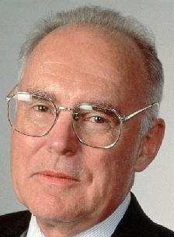
Great Idea #2: Moore’s Law - 2005
Transistors
Per Die
“Reduced cost is one of the big attractions of integrated electronics, and the cost advantage continues to increase as the technology evolves toward the production of larger and larger circuit functions on a single semiconductor substrate.”
Electronics, Volume 38,
Number 8, April 19, 1965
10¹⁰
10⁹
10⁸
10⁷
Gordon Moore Intel Cofounder B.S. Cal 1950!
10⁶
10⁵
10⁴
10³
10²
1965 Data (Moore)
Predicted 2x transistors/chip every 2 years
10¹
10⁰
1960
1965
1970
1975
1980
1985
1990
1995
2000
2005
2010
Source: Intel

Slide 19
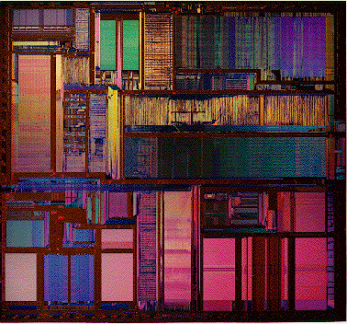

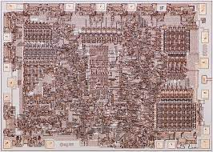
Great Idea #2: Moore’s Law - 2005
Transistors
Per Die
Intel Pentium
1993
3.1 million transistors
10¹⁰
1G
2G
10⁹
512M
Intel 8008
1972
3500 transistors
256M
10⁸
128M
Itanium™ 2 Processor
64M
16M
Itanium™ Processor
10⁷
4M
Pentium® 4 Processor
1M
Pentium® III Processor
10⁶
256K
Pentium® II Processor
64K
Pentium® Processor
10⁵
16K
486™ Processor
4K
386™ Processor
10⁴
80286
1K
8080
8086
10³
8008
10²
4004
1965 Data (Moore)
Memory
10¹
Microprocessors
10⁰
1960
1965
1970
1975
1980
1985
1990
1995
2000
2005
2010
Source: Intel
Notes:
Intel 8008, 1972, 3500 transistors
Intel Pentium, 1993, 3.1 million transistors

Slide 20
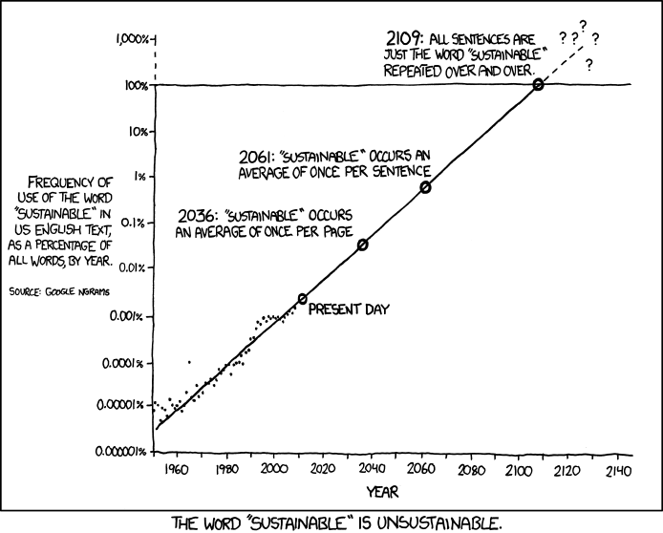
Law of Sustainability
Notes:
Source: https://xkcd.com/1007/

Slide 21
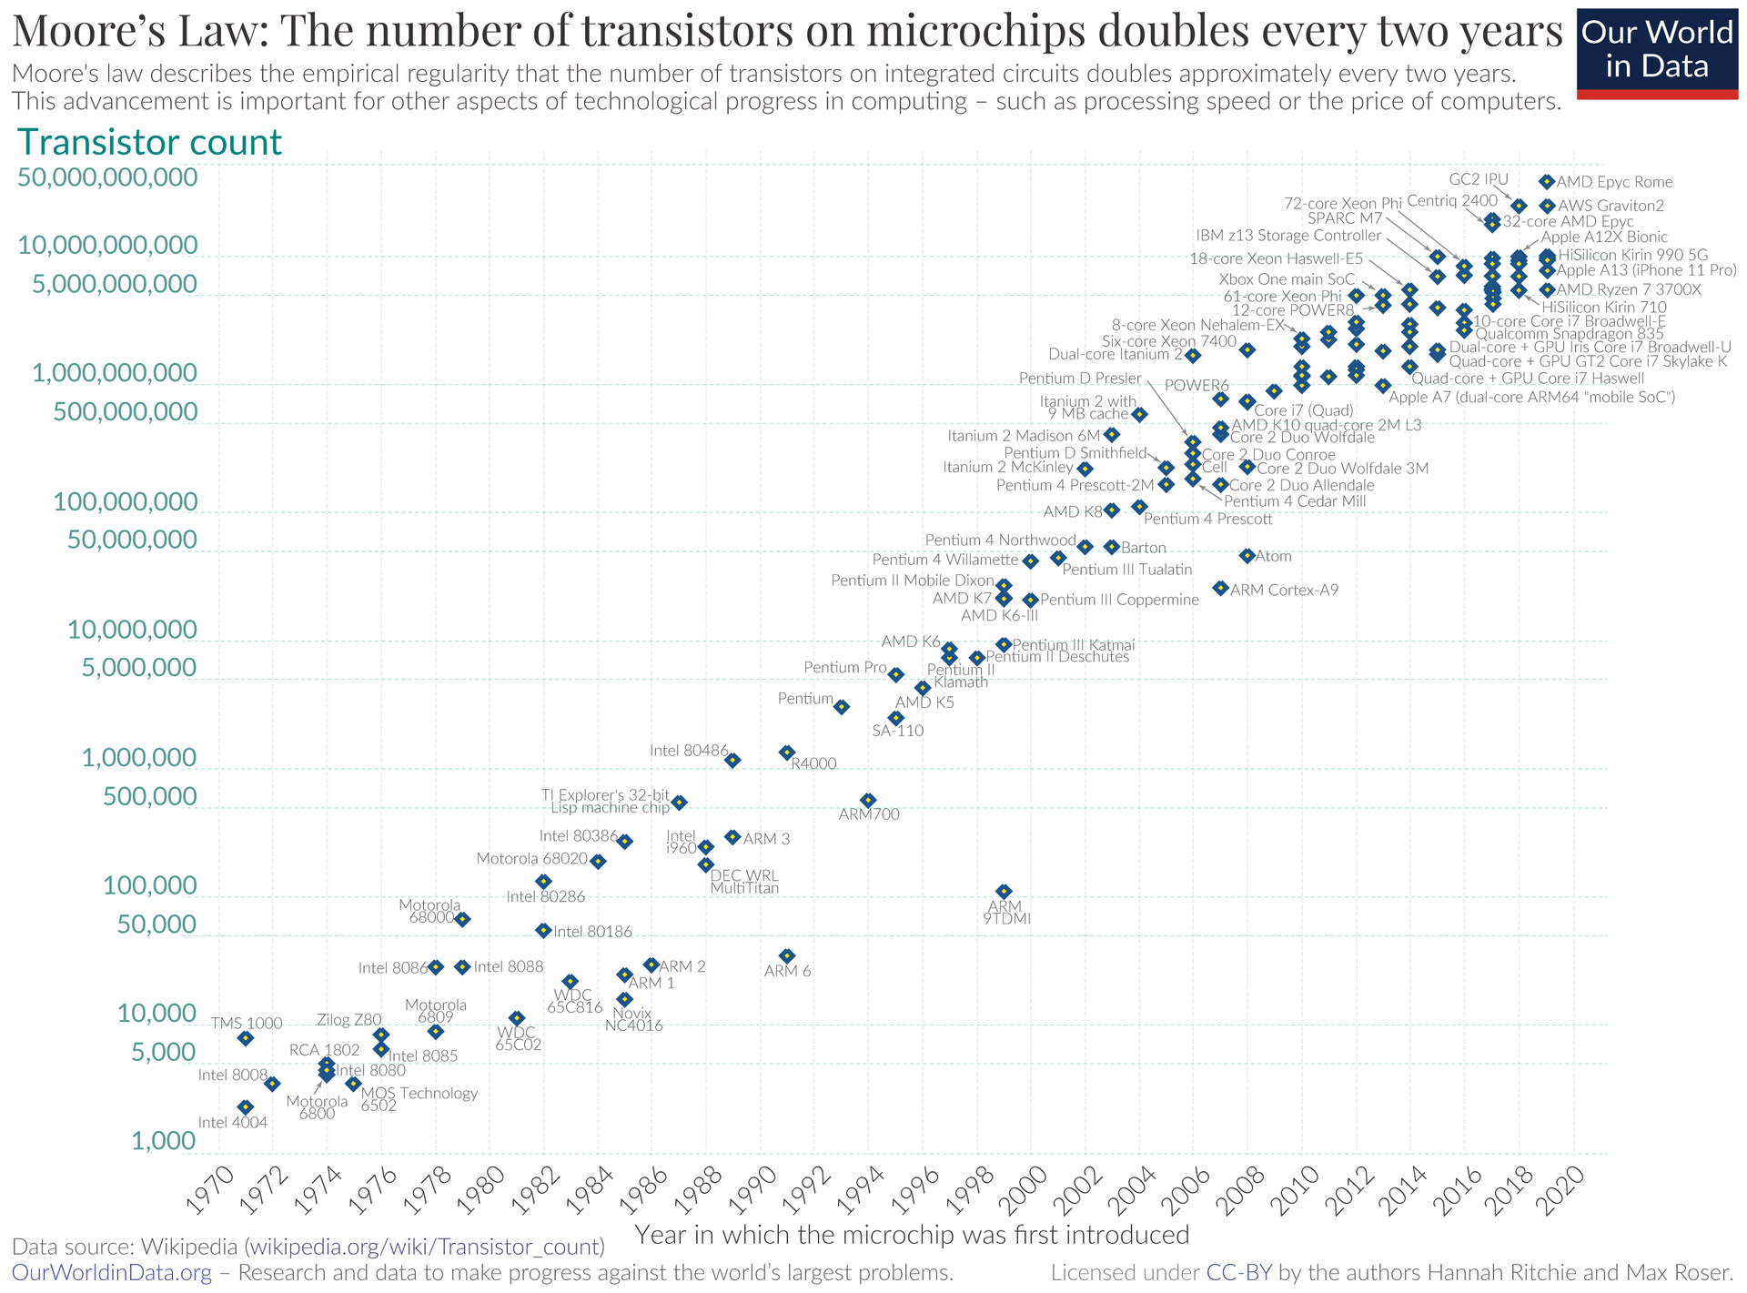
Moore’s Law…?
Seems to be tapering?
More on this in a bit…

Slide 22
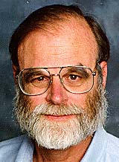





Great Idea #3: Principle of Locality / Memory Hierarchy
Storage Latency Analogy: How Far Away is the Data?
Andromeda
10⁹
Tape /optical
2,000 Years
robot
10⁶
Disk
Pluto
2 Years
Jim Gray Turing Award
B.S. Cal 1966
Ph.D. Cal 1969
100
Memory
Sacramento
1.5 hr
10
On-board cache
This Campus
10 min
2
On-chip cache
This Room
1
Registers
My Head
1 min
[ns]
Notes:
Turing award (1998) for "for seminal contributions to database and transaction processing research and technical leadership in system implementation"

Slide 23
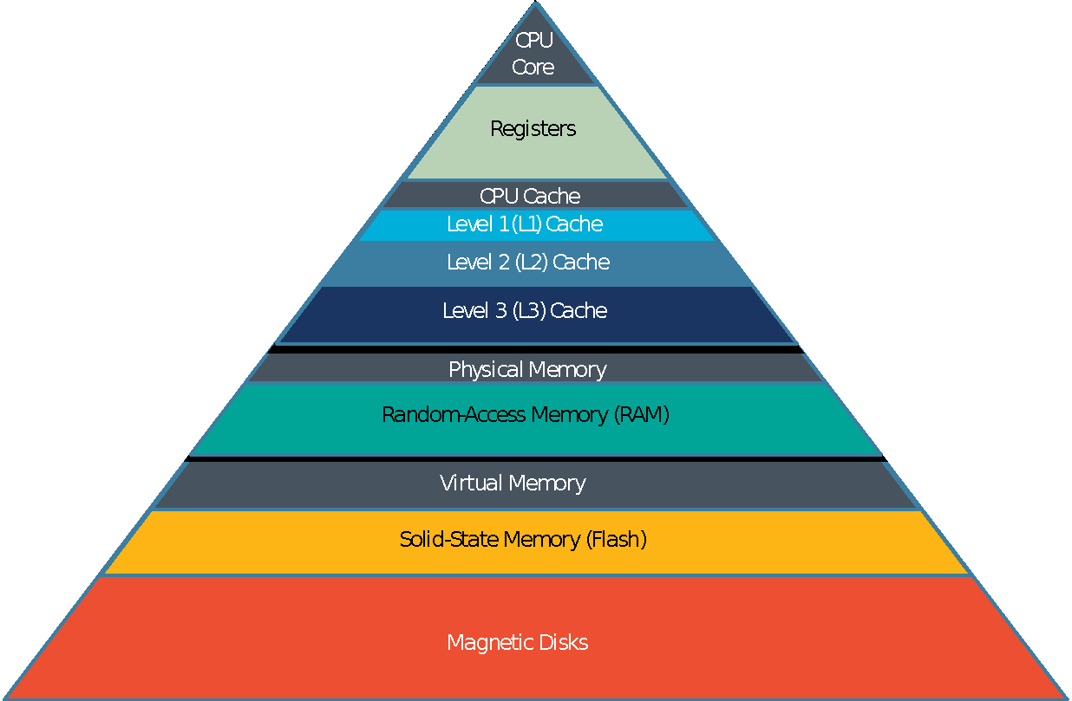
Great Idea #3: Principle of Locality / Memory Hierarchy
Processor chip
Extremely fast
Extremely expensive Tiny capacity
Faster
Expensive Small capacity
DRAM chip –e.g. DDR3/4/5 HBM/HBM2/3
Fast
Priced reasonably Medium capacity
SSD, HDD Drives
Fast
Cheap Large
capacity

Slide 24

Great Idea #4: Parallelism (1/3)
In time slot 3,
Instruction 1 is being executed
Instruction 2 is being decoded
And Instruction 3 is being fetched from memory
Instruction-Level Parallelism

Slide 25

Great Idea #4: Parallelism (2/3)
Thread-Level Parallelism

Slide 26
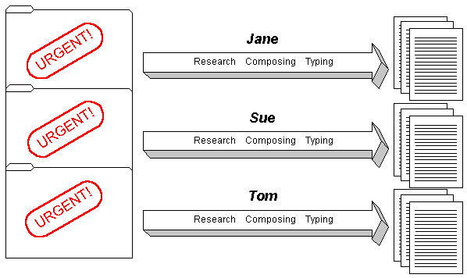

Great Idea #4: Parallelism (3/3)
Data-Level Parallelism

Slide 27
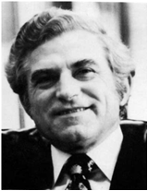
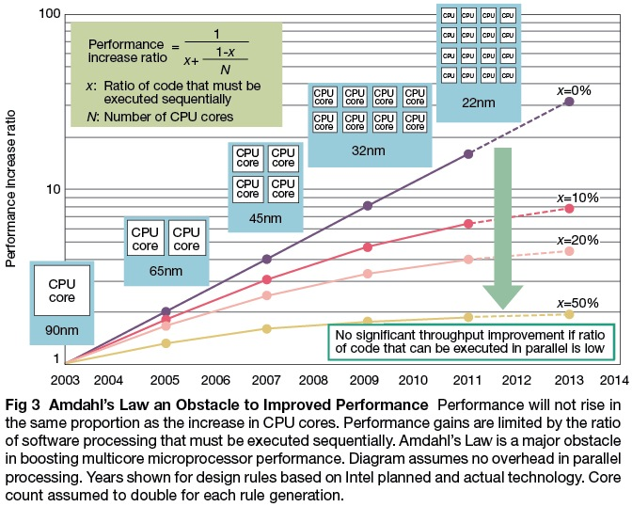
Caveat! Amdahl’s Law
Gene Amdahl
Computer Pioneer

Slide 28
Great Idea #5: Performance Measurement & Improvement
Match application to underlying hardware to exploit:
Locality;
Parallelism;
Special hardware features, like specialized instructions (e.g., matrix manipulation).
Latency/Throughput:
How long to set the problem up and complete it (or how many tasks can be completed in given time)
How much faster does it execute once it gets going
Latency is all about time to finish.

Slide 29

Great Idea #6: Dependability via Redundancy
Unintended transistor behavior can be caused by unintended electron flow from cosmic rays (among other reasons)!
https://www.exploratorium.edu/exhibits/cloud-chamber
Notes:
https://www.youtube.com/watch?v=jh7SzrNWGhI

Slide 30
Great Idea #6: Dependability via Redundancy
Design with redundancy so that a failing piece doesn’t make the whole system fail.
1+1=2
2 of 3 agree ✅
1+1=2
1+1=2
1+1=1
Increasing transistor density reduces the cost of redundancy

Slide 31
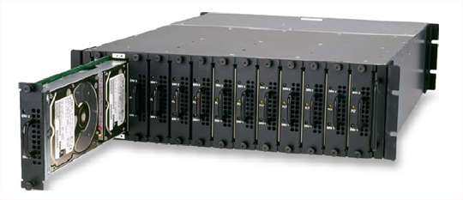
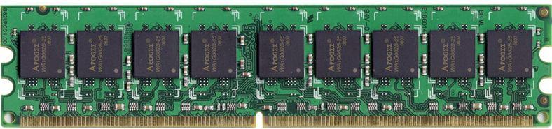
Great Idea #6: Dependability via Redundancy
Applies to everything from datacenters to storage to memory to instructors!
Redundant datacenters so that can lose 1 datacenter but Internet service stays online;
Redundant disks so that can lose 1 disk but not lose data (Redundant Arrays of Independent Disks/RAID);
Redundant memory bits so that can lose 1 bit but no data (Error Correcting Code/ECC Memory).

Slide 32
(dramatic pause)

Slide 33
Why should you care about computer architecture?

Slide 34

Why should you care about computer architecture?
Smartphones
Apps
Healthcare
Telemedicine
Education
Autonomy
Gaming
Entertainment, VR/AR
Visualization
Personal Computers
WWW
Mainframes
Scientific computing
Data processing
Cloud
1970 1980 1990 2000 2010 2020 2030
Number of deployed devices continues to grow, but there is no single killer application.
Diversification of needs, architectures
Machine learning is common for most domains
Notes:
Goal: fast programs, low cost (power dissipation)
Moore’s law
Past: clock speed increased every year 🡪 programs automatically got faster
Today: Clock speed stays constant 🡪 only creativity can make programs faster
E.g. parallel processing
61C: learn how to increase speed by over 100x for some algorithms
Combination of architectural innovations and programming innovations

Slide 35
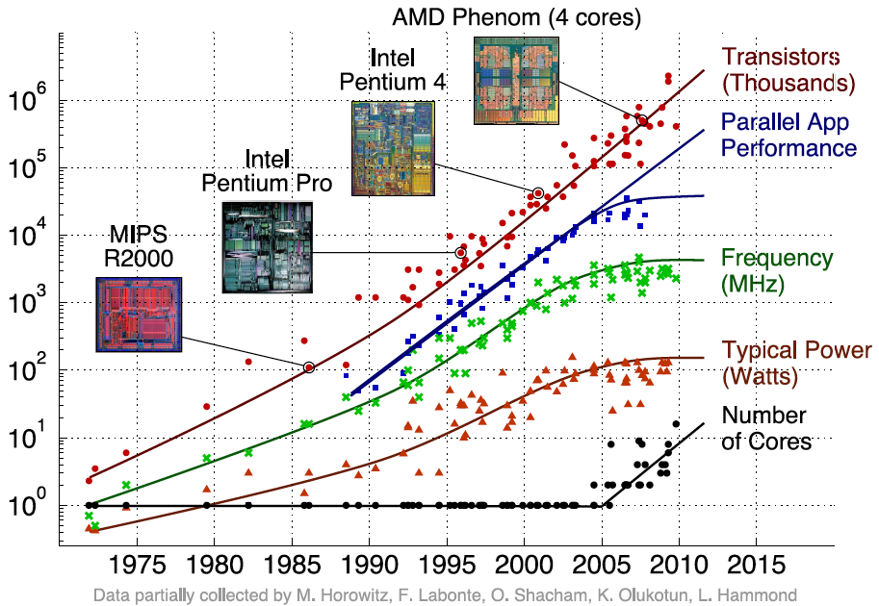
Reason 1: Changing Constraints
Moore’s Law ending
Power limitations
Amdahl’s Law
Notes:
386, 1985, 299,000 transistors
Pentium, 1993, 3.1 million trani

Slide 36
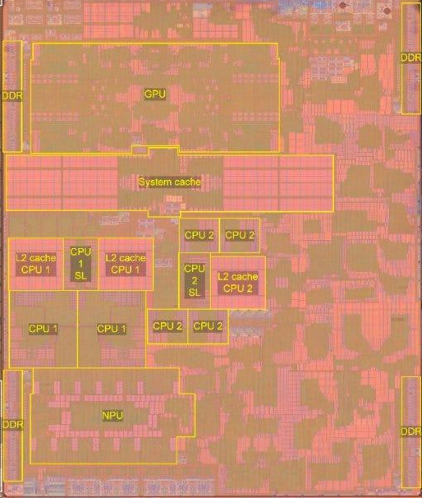
Reason 2: Era of Domain-Specific Computing
Each domain requires heterogeneous systems.
Multiple processor cores
GPUs,
NPUs,
accelerators,
interfaces,
memory, …
Apple A15 Bionic Source: SemiAnalysis
Notes:
Apple A15 Bionic on iPhone 13, iPhone SE,
Released 2021

Slide 37
Old Conventional Wisdom
Moore’s Law + Dennard Scaling = faster, cheaper, lower-power general-purpose computers each year
In glory days, 1%/week performance improvement!
Dumb to compete by designing parallel or specialized computers
By time you’ve finished design, the next generation of general-purpose will beat you!

Slide 38
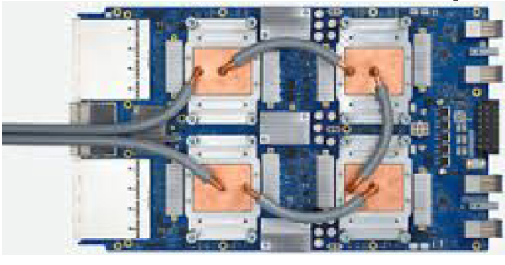
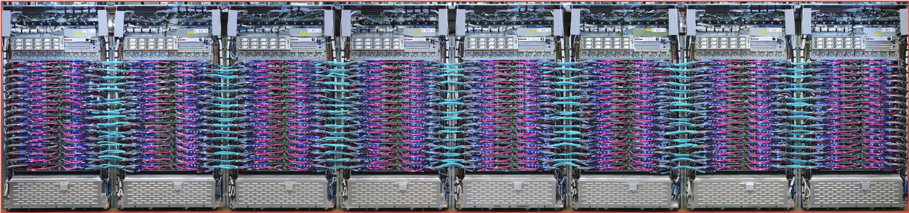
New Conventional Wisdom
Google TPU3
Specialized Engine for training Neural Networks
Deployed in cloud
1024 chips, > 100PetaFLOPs

Slide 39
Why should you care about computer architecture?
High Level Language Program (e.g., C)
temp = v[k];
v[k] = v[k+1];
v[k+1] = temp;
Compiler
Anything can be represented as a number, i.e., data or instructions
Assembly Language Program (e.g., RISC-V)
lw x3, 0(x10)
lw x4, 4(x10)
sw x4, 0(x10)
sw x3, 4(x10)
Assembler
1000 1101 1110 0010 0000 0000 0000 0000
1000 1110 0001 0000 0000 0000 0000 0100
1010 1110 0001 0010 0000 0000 0000 0000
1010 1101 1110 0010 0000 0000 0000 0100
Machine Language Program (RISC-V)
Hardware Architecture Description (e.g., block diagrams)
+4
Reg
[]
pc
pc+4
1
wb
DataD
Reg
[rs1]
1
ALU
alu
2
alu
0
pc
IMEM
inst
[11:7]
AddrD
Reg
[rs2]
0
Addr
DMEM
1
wb
pc+4
inst
[19:15]
AddrA
DataA
Branch
0
DataW
DataR
mem
0
Architecture Implementation
inst
[24:20]
AddrB
DataB
Comp.
1
Logic Circuit Description (Circuit Schematic Diagrams)
inst
[31:7]
Imm
.
imm
[31:0]
Gen

Slide 40
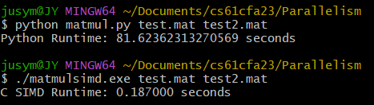
Why should you care about computer architecture?
Hardware decides how fast software runs.
Code designed with hardware in mind is ~100x faster than general-purpose code.
All industrial-grade software are built with hardware in mind
440x Faster than Python!!!

Slide 41
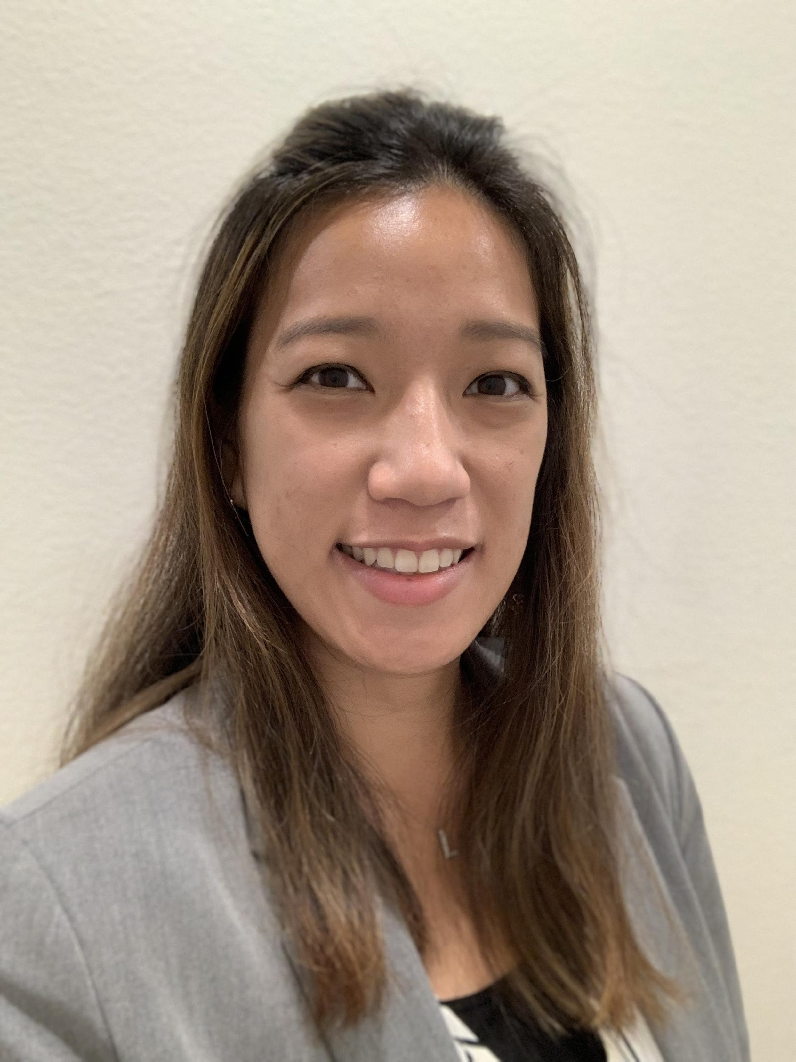
Agenda
What you need to know about this class
Thinking about Machine Structures
Great Ideas in Computer Architecture
What you need to know about this class

Slide 42

Yoda says…
“Always in motion, the future is…”
Our schedule may change slightly depending on some factors. This includes lectures, assignments & labs…

Slide 43
Course Information
Course Website: https://cs61c.org/
Instructors: Lisa Yan & Justin Yokota
Teaching Assistants: (see webpage)
EdStem
Every announcement, discussion, clarification happens here
Optional Readings: avg 15 pages of reading/week
Patterson & Hennessy, Computer Organization and Design, RISC-V ed
Kernighan & Ritchie, The C Programming Language, 2nd Edition
Barroso & Holzle, The Datacenter as a Computer, 3rd Edition

Slide 44
Course Information
Course Website: https://cs61c.org/
Instructors: Lisa Yan & Justin Yokota
Teaching Assistants: (see webpage)
EdStem
Every announcement, discussion, clarification happens here
Optional Readings: avg 15 pages of reading/week
Patterson & Hennessy, Computer Organization and Design, RISC-V ed
Kernighan & Ritchie, The C Programming Language, 2nd Edition
Barroso & Holzle, The Datacenter as a Computer, 3rd Edition
Today’s required reading: Our Course Policies page!
https://cs61c.org/sp24/policies/
The next few slides are an overview; for details, read our policies.

Slide 45
Course Format Summary (1/2)
Lecture
MWF for an hour, in-person + on Zoom. Or watch recording. No attendance taken.
Homework (due Thursdays) and Discussion (WTh)
Design, Analyze, Illustrate
Lab (MTu) and Project, due Tuesdays
Implement, Simulate, Debug
Midterm and Final Exam
Rock on!!! Show your stuff!!!
Lab 00 (Setup) due Su 1/21
Lab 01, Discussion 01 sections start next week

Slide 46
Course Format Summary (2/2)
Office Hours
TA: Full in-person or full online; queue-based
Instructor: In-person, group-based; “Concept OH” for exam prep. “Tea Hours” for advising.
Project Parties
Throughout the semester, pre-deadline
Extension form
Late policy for all assignments (see website)
If you can’t meet deadline, ask!

Slide 47
Lateness and Accommodations Policy
All assignments are due at 11:59:59 PM PT.
There are two forms on the website:
One form for normal extensions (≤ 1 day for labs/HWs, ≤2 for projects), and
One form for extenuating circumstances.
Please don’t hesitate to proactively ask for accommodations.
We know life happens!
We’re here to help and support students.

Slide 48
Exams
Midterm Exam: Wednesday, 3/13 7:00–9:00 PM PT
In-person, evening, standard paper exam.
ONE alternate slot for exam conflicts (time TBD).
No remote exams outside emergency circumstances.
Final Exam: Tuesday, 5/7 3:00–6:00 PM PT
In-person, scheduled exam slot, standard paper exam.
ONE alternate slot for exam conflicts (time TBD).
No remote exams outside emergency circumstances.
Cumulative; see Policies page for more details.

Slide 49
Course Grading (1/2)
Labs (8%)
Homework (12%)
Projects (40%)
Non-Parallel Application (C)
RISC-V Application
Computer Processor Design (Logisim)
Parallelization C Program
ALL projects can be done individually or with partners
Midterm (16%)
Final (24%)
Project partners mean synchronous, collaborative work! See Policies page for more details.

Slide 50
Course Grading (2/2)
Absolute Grading! (not curved!)
https://eecs.berkeley.edu/resources/faculty-staff/academic-personnel/grading-guidelines-undergrad/
“A typical GPA for courses in the lower division is 2.8-3.3. This GPA would result, for example, from 35% A’s, 45% B’s, 13% C’s, 7% D’s,F’s.”
Job/Intern Interviews: They grill you with technical questions, so it’s what you know and can do, not your GPA.
CS61C gives good stuff to say!

Slide 51
(somber pause)

Slide 52
Collaboration and Independent Work Policy
Assignment Collaboration:
All homework and labs are to be your work ALONE.
Projects can be done either solo or in pairs.
Partners commit to the responsibility to work together synchronously.
PARTNER TEAMS MAY NOT WORK WITH OTHER PARTNER TEAMS.
You are encouraged to help teach others debugging strategies.
Beyond that, we don’t want you sharing/soliciting approaches nor ideas nor code nor whiteboarding with other students! Sometimes, the point of the assignment WAS the “algorithm.” And if you share that, they won’t learn what we want them to learn).
HKN and tutoring sessions that work you through the pseudocode are not allowed.
The pseudocode is sometimes the entire point! Feel free to answer questions on Ed that help them debug (don’t share code, even snippets there). We expect that what you hand in is yours.

Slide 53
Excessive Collaboration and Academic Misconduct
It is NOT acceptable:
To copy or look at solutions from other students, for any reason.
To copy or look at (or start your) solutions from the Web, for any reason.
To be irresponsible and create opportunities for unscrupulous students (e.g., public GitHubs, walking away while logged on, leaving notes around, etc.).
We have tools and methods, developed over many years, for detecting this. You WILL be caught, and the penalties WILL be severe. If you have questions whether a behavior is crossing the line, ask!
At minimum: negative points in the assignment AND a report to the Center of Student Conduct.
Both Giver and Receiver are equally culpable and suffer equal penalties.
50-100 students are caught every semester.
We also check intermediate student work—accounted for 60% of Fall 2023 cases.
Plagiarism at any point in your work is unacceptable.

Slide 54
Read our Course Policies in full:
https://cs61c.org/sp24/policies/

Slide 55

Our goals as instructors
To make your experience in CS61C as enjoyable & informative as possible
Humor, enthusiasm, guests, technology-in- the-news in lecture
Fun, challenging projects & HW
Pro-student accommodations policies
To maintain Cal standards of excellence
Projects & exams as rigorous as every year.
To be solid undergraduate instructors
Please give feedback so we can improve!

Slide 56
Summary
CS61C: Learn Great Ideas in Computer Architecture to enable high performance programming via parallelism, not just learn C.
Abstraction (Layers of Representation / Interpretation)
Moore’s Law
Principle of Locality/Memory Hierarchy
Parallelism
Performance Measurement and Improvement
(Extra) Dependability via Redundancy

